Slide 1







Product Flow Model
Product Volumes
(Daily, Monthly)
Analysis & Optimization
Applications
Raw Readings Database
Inventory
Database
Summaries
Database
Product Volumes
(Low Frequency)
TimeSeries
(High Frequency)
Alerting
Central PI
Area PI
Area PI
Local PI
Local PI
Local PI
Local PI
SCADA
SCADA
SCADA
SCADA
RTU
RTU
RTU
RTU
RTU
RTU
RTU
RTU
Sensor
Sensor
Sensor
Sensor
Sensor
Sensor
Sensor
Sensor
Sensor
Sensor
Sensor
Sensor
Sensor
Sensor
Sensor
Sensor
At the Field
At the Field
At the Field
At the Field

Slide 2
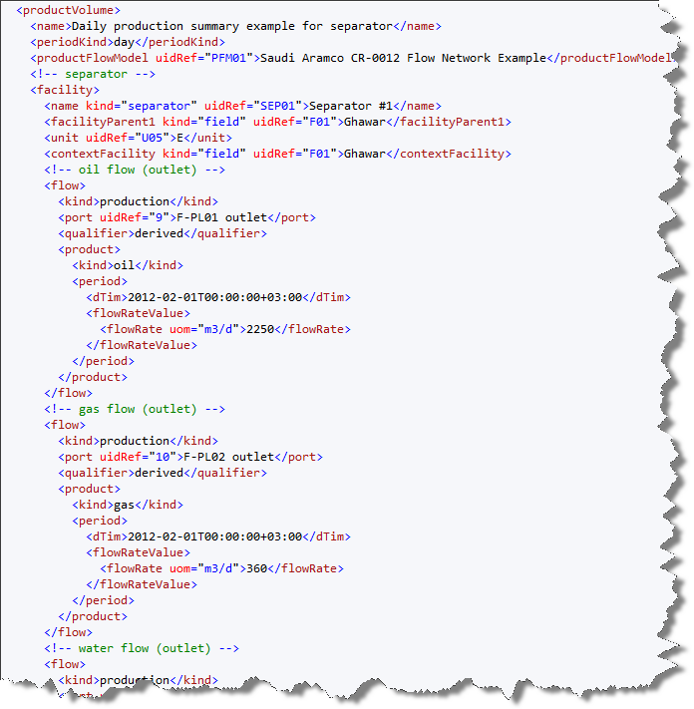
Daily summary for oil
Daily summary for gas

